Slide 1
DCIT 25 Data Structures and Algorithms Trees Traversal

Slide 2
ReVIEW
Introduction to trees
Binary trees

Slide 3
Tree
A tree is a collection of nodes.
The collection can be empty; otherwise, a tree consists of a distinguished node r, called the root, and zero or more non-empty (sub) trees T₁, T₂, …, T_{k} each of whose roots are connected by a directed edge from r.
A tree is a collection of N nodes, one of which is the root and N-1 edges.

Slide 4
Tree terminology
The root of each subtree is said to be a child of r and r is said to be the parent of each subtree root.
Leaves: nodes with no children (also known as external nodes)
Internal Nodes: nodes with children
Siblings: nodes with the same parent

Slide 5
Tree terminology (continued)
A path from node n₁ to n_{k} is defined as a sequence of nodes n₁, n₂, …, n_{k} such that n_{i} is the parent of n_{i+1} for 1<= i <= k.
The length of this path is the number of edges on the path namely k-1.
The length of the path from a node to itself is 0.
There is exactly one path from the root to each node.

Slide 6
Tree terminology (continued)
Depth (of node): the length of the unique path from the root to a node.
Depth (of tree): The depth of a tree is equal to the depth of its deepest leaf.
Height (of node): the length of the longest path from a node to a leaf.
All leaves have a height of 0
The height of the root is equal to the depth of the tree

Slide 7
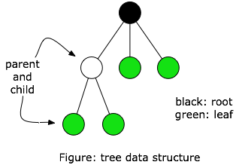
Tree Terminology
root, leaf
parent, child, sibling
subtree
external, internal node
ancestor, descendant
depth, height

Slide 8
Binary trees
A binary tree is a tree in which no node can have more than two children.
Each node has an element, a reference to a left child and a reference to a right child.

Slide 9
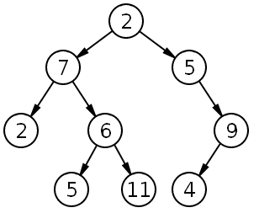
Binary Trees
Each node has 0, 1, or 2 children

Slide 10
a binary tree
a
b
c
d
e
f
g
h
i
j
k
l

Slide 11
Tree traversals

Slide 12
Tree traversals
A binary tree is defined recursively: it consists of a root, a left subtree, and a right subtree
To traverse (or walk) the binary tree is to visit each node in the binary tree exactly once
Tree traversals are naturally recursive
Since a binary tree has three “parts,” there are six possible ways to traverse the binary tree:
root, left, right
left, root, right
left, right, root
root, right, left
right, root, left
right, left, root

Slide 13
Depth-First Traversals
CODE | for each Node: | Name
public void preorderTraversal(Visitor v){ if(!isEmpty() && ! v.isDone()){ v.visit(getKey()); getLeft().preorderTraversal(v); getRight().preorderTraversal(v); } } | Visit the node Visit the left subtree, if any. Visit the right subtree, if any. | Preorder (N-L-R)
public void inorderTraversal(Visitor v){ if(!isEmpty() && ! v.isDone()){ getLeft().inorderTraversal(v); v.visit(getKey()); getRight().inorderTraversal(v); } } | Visit the left subtree, if any. Visit the node Visit the right subtree, if any. | Inorder (L-N-R)
public void postorderTraversal(Visitor v){ if(!isEmpty() && ! v.isDone()){ getLeft().postorderTraversal(v) ; getRight().postorderTraversal(v); v.visit(getKey()); } } | Visit the left subtree, if any. Visit the right subtree, if any. Visit the node | Postorder (L-R-N)

Slide 14
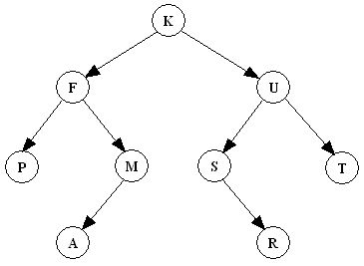
Preorder traversal
In preorder, the root is visited first
Root, left, right

Slide 15
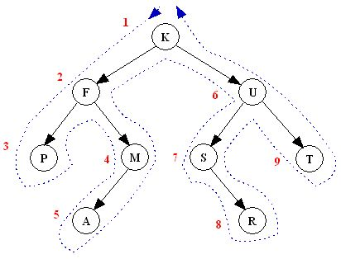
Preorder Depth-first Traversal
N-L-R
“A node is visited when passing on its left in the visit path”
K F P M A U S R T

Slide 16
Inorder traversal
In inorder, the root is visited in the middle
Left, root, right

Slide 17
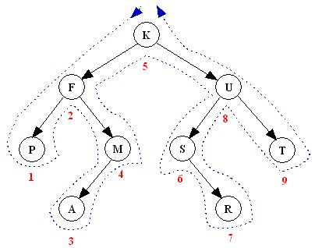
Inorder Depth-first Traversal
L-N-R
“A node is visited when passing below it in the visit path”
Note: An inorder traversal can pass through a node without visiting it at
that moment.
P F A M K S R U T

Slide 18
Postorder traversal
In postorder, the root is visited last
Left, right, root

Slide 19
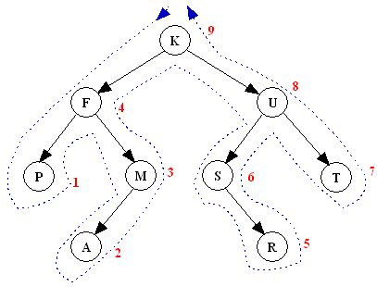
Postorder Depth-first Traversal
L-R-N
“A node is visited when passing on its right in the visit path”
Note: An postorder traversal can pass through a node without visiting it at that moment.
P A M F R S T U K

Slide 20
Tree traversals using “flags”
The order in which the nodes are visited during a tree traversal can be easily determined by imagining there is a “flag” attached to each node, as follows:
preorder
inorder
postorder
To traverse the tree, collect the flags:
A
A
A
B
C
B
C
B
C
D
E
F
G
D
E
F
G
D
E
F
G

Slide 21
Tree traversals using “flags”
The order in which the nodes are visited during a tree traversal can be easily determined by imagining there is a “flag” attached to each node, as follows:
preorder
inorder
postorder
To traverse the tree, collect the flags:
A
A
A
B
C
B
C
B
C
D
E
F
G
D
E
F
G
D
E
F
G
A B D E C F G
D B E A F C G
D E B F G C A

Slide 22
Other traversals
The other traversals are the reverse of these three standard ones
That is, the right subtree is traversed before the left subtree is traversed
Reverse preorder: root, right subtree, left subtree
Reverse inorder: right subtree, root, left subtree
Reverse postorder: right subtree, left subtree, root

Slide 23
Reverse Depth-First Traversals
There are 6 different depth-first traversals:
NLR (pre-order traversal)
NRL (reverse pre-order traversal)
LNR (in-order traversal)
RNL (reverse in-order traversal)
LRN (post-order traversal)
RLN (reverse post-order traversal)
The reverse traversals are not common

Slide 24
Reverse Depth-First Traversals
Exercise: Perform each of the reverse depth-first traversals on the tree:

Slide 25
Arithmetic Expression Tree
Binary tree for an arithmetic expression
internal nodes: operators
leaves: operands
Example: arithmetic expression tree for the expression
((2 × (5 - 1)) + (3 × 2))
+
×
×
2
−
3
2
5
1

Slide 26
Arithmetic Expressions
inorder traversal
+
×
×
2
−
3
2
5
1
What is the answer?

Slide 27
Arithmetic Expressions
inorder traversal
+
×
×
2
−
3
2
5
1
((2 × (5 - 1)) + (3 × 2))

Slide 28
Evaluate Arithmetic Expressions
postorder traversal
Recursively evaluate subtrees
Apply the operator after subtrees are evaluated
+
×
×
2
−
3
2
5
1

Slide 29
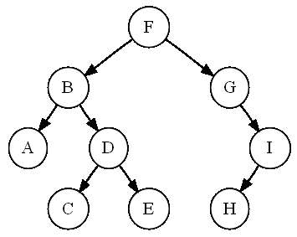
Traversal Exercise
Find the:
preorder
inorder
postorder
level-order

Slide 30
Exercise Answers
Preorder traversal sequence: F, B, A, D, C, E, G, I, H (root, left, right)

Slide 31
Exercise Answers
Inorder traversal sequence: A, B, C, D, E, F, G, H, I (left, root, right)

Slide 32
Exercise Answers
Postorder traversal sequence: A, C, E, D, B, H, I, G, F (left, right, root)

Slide 33
Exercise Answers
Level-order traversal sequence: F, B, G, A, D, I, C, E, H

Slide 34
End…
Thank you for listening..
Keep safe!…
God bless!…

